Slide 1
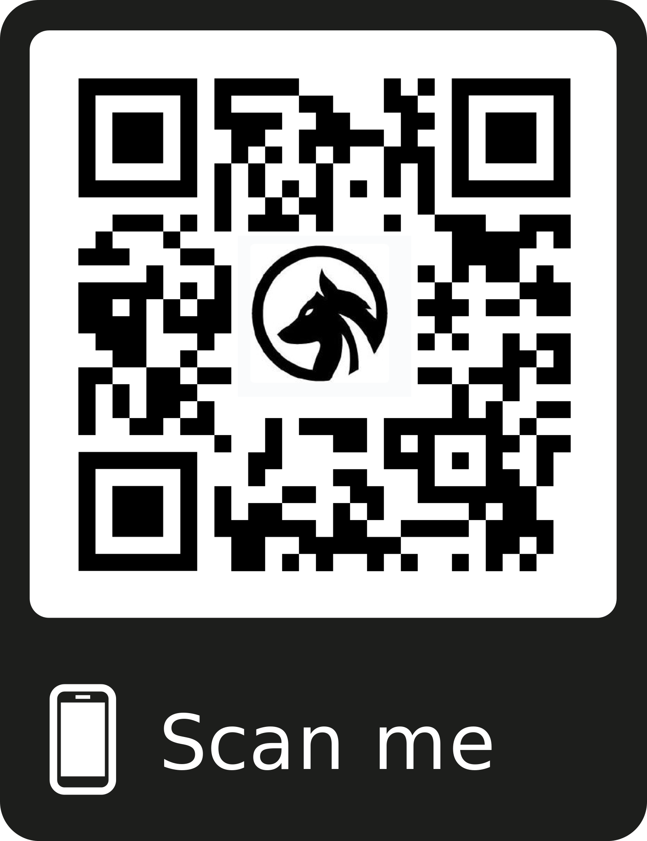
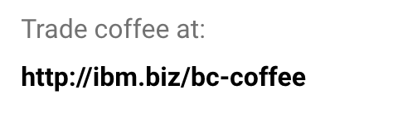

Join a Coffee Blockchain!
Network: Wolfpack
Password:IBMC10ud
Follow @IBMWolfpack
for winner announcements
Notes:
Admin View: http://blockchain-coffee-web.mybluemix.net/

